Slide 1
Razor Tutorial
Date

Slide 2
Razor Basics
What is Razor
Razor is a mark-up syntax that lets you embed server based code into web pages
Razor is based on ASP.Net and has a syntax similar to PHP and Classic ASP
Razor design goals
Microsoft wanted Razor to be easy to use and easy to learn, and work inside of tools like Visual Studio so that IntelliSense is available, the debugger is available, but they wanted Razor to have no ties to a specific technology, like ASP.NET or ASP.NET MVC.
Razor – View Engine in MVC
View Engines are responsible for creating HTML from the views
Razor is optimized around HTML generation

Slide 3
Razor Syntax
<ul>
@for (int i = 0; i < 10; i++) {
<li>@i</li>
}
</ul>
Remeber the @ - for writing C# / VB code Razor supports both C# and VB
Single statement block
Multi statement block
Razor is clever at distinguishing between mark up and C# code

Slide 4
Main Razor Syntax Rules for C#
Razor code blocks are enclosed in @{ ... }
Inline expressions (variables and functions) start with @
Code statements end with semicolon
Variables are declared with the var keyword
Strings are enclosed with quotation marks
C# code is case sensitive and C# files have the extension .cshtml

Slide 5
Razor – How does it work
Based on ASP.Net framework and has inherited all its power
Razor page has code and HTML
Server executes the Razor code first before sending HTML to the browser

Slide 6
Data Types
int | Integer (whole numbers) | 103, 12, 5168
float | Floating-point number | 3.14, 3.4e38
decimal | Decimal number (higher precision) | 1037.196543
bool | Boolean | true, false
string | String | "Hello ", "John"

Slide 7
Converting Data Types
AsInt() IsInt()
AsFloat()
IsFloat()
AsDecimal() IsDecimal()

Slide 8
Converting Data Types
AsDateTime() IsDateTime()
AsBool() IsBool() ToString() Example:
if (myString.IsInt())
{myInt=myString.AsInt();}

Slide 9
Loops
Using Razor Expressions
Operators
Supports the C# list of operators
For Loops
For Each Loops
While Loops
Conditions
if else
while
switch

Slide 10
VIEWS

Slide 11
Views
View Engine
Razor Engine is an advanced view engine that was introduced with MVC3. This is not a new language but it is a new markup syntax.
Namespace for Razor Engine System.Web.Razor
Razor has new syntax and advance syntax that are compact,expressive and reduces typing
View is responsible for providing the UI to the user
View transforms the Model data to the format in which it needs to be presented to the user
The views are added to the Views Folder under a subfolder with a Controller name.
The view name is mapped to the Controller Action Name

Slide 12
Razor Views
The views are Razor Views
The Layout template + Razor View forms the output.
ViewData and ViewBag
Used for passing data from controller to view and in next request
ViewData is a dictionary of objects that is derived from ViewDataDictionary class and is accessible using strings as keys.
ViewBag is a dynamic property that takes advantage of the new dynamic features in C# 4.0.
ViewData requires typecasting for complex data type and check for null values to avoid error.
ViewBag doesn’t require typecasting for complex data type.

Slide 13
Strongly Typed Views
ViewData is a ViewDataDictionary
In the Controller method use the overload of View method to specify the model
This sets the ViewData.Model property to the Model
Then specify the @model in View Example
@model IEnumerable<MvcRestaurants.Models.RestaurantReview>

Slide 14
Default Views and Views in Other Locations
If no view is specified the Index View is considered
Views can be picked up from different directories by specifying the path with a ~
Razor Expressions
Implicit
@item.Rating
Explicit
@(item.Rating /10.0)

Slide 15
Razor Code Blocks
Razor is smart enough to distinguish between C# and Razor code.
Razor Comments and Escape
@* *@ is for Comments
@@ - To escape
@: - To output a string

Slide 16
Layout Pages
Provides the skeleton
It is similar to master pages
Contains methods RenderBody() and RenderSection
RenderBody is responsible for rendering the action specific views

Slide 17
Layout View
<!DOCTYPE html>
<html>
<head>
<title>@ViewBag.Title</title>
<script src="@Url.Content("~/Scripts/jquery-1.4.4.min.js")" type="text/javascript"></script>
</head>
<body> @RenderBody() </body>
</html>

Slide 18
_ViewStart
This is where the layout view for the application is defined
This can be overridden by specifying a layout inside the folders. The one in the folders take precedence
Layout can also be null

Slide 19
Partial Views
Partial Views are reusable Views within the application
Partial Views can be called using @Html.Partial
They can also be called using @Html.Action which calls a sub-request to render a partial view
ChildActionOnly restricts calling it from HTML.Action

Slide 20
Alternate View Engines
Spark - Spark is a open source view engine for ASP.NET MVC projects as well as Castle MonoRail framework projects. This view engine is from the popular MVCContrib library.
NHaml - NHaml is another View Engine and works like an replacement of inline page templating .

Slide 21
Alternate View Engines
NDjango - NDjango is an implementation of Django Template Language using F#.
Hasic -Hasic is a ASP.NET View Engine that uses the VB.NET XML kind of literals.
Bellevue – Bellevue is another cool ASP.NET MVC View Engine that has the design goal which respects the HTML as first class

Slide 22
Child Actions
A controller is a collection of action methods.
Action methods are just like methods and have a public access specifier.
Since they are public we can easily call them from a URL request directly from the browser.
In our projects, when we want an action method to not be called from a URL request we should make the method a child action method.
An action method can be a child or a normal action method, but child actions are action methods invoked from within a view, you cannot invoke a child action method via user request (URL).
We can annotate an action method with the [ChildActionOnly] attribute to create a child action. Normally we use child action methods with partial views.

Slide 23
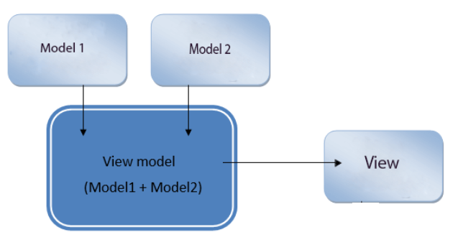
Using a ViewModel Object
ViewModels are used to shape multiple entities from one or more models into a single object. This conversion into single object provides us better optimization

Slide 24
Bundling and minification techniques were introduced in MVC 4 to improve request load time.
Bundling
Bundling allow us to load the bunch of static files from the server into one http request.
Minification
Minification technique optimizes script or css file size by removing unnecessary white space and comments and shortening variable names to one character.

